Slide 1
Mod 01 Python Flow Control
Scripting Essentials
Dr. Burkman

Slide 2
Learning Objectives
In this module you will learn the basic Python components to control the flow of your script.
Booleans
IF
WHILE
FOR
BREAK/CONTINUE
Functions

Slide 3
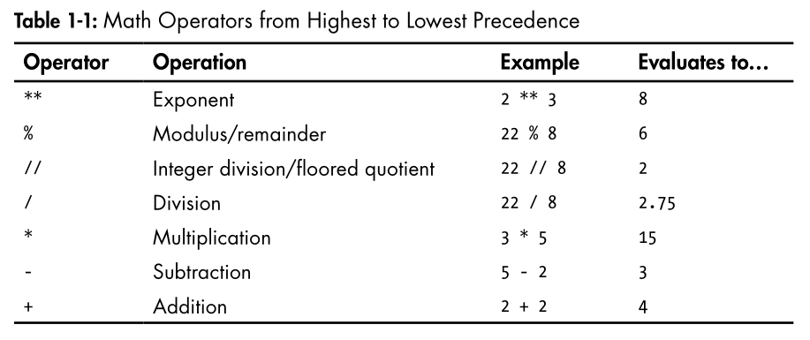
Python Basics
Values with an operator make up an expression
2 + 2 is an expression
Basic Python math operators (and they adhere to PEMDAS):

Slide 4
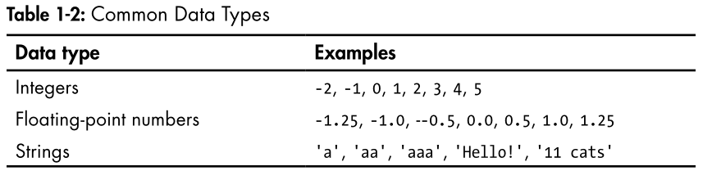
Python Basics
Python common data types are about what you expect.
You can use “ or ‘ in matching pairs around text, but be consistent. A nice approach is to use “ if there is a ‘ in your text (“Jim’s Garage”) otherwise stick with ‘ (‘The Garage of Jim’)

Slide 5
Python Basics
Using + means two things:
It adds numbers (5 + 2)
It concatenates strings (‘Jim ‘ + ‘and ‘ + ‘Nita’)
Using * means two things:
It multiplies numbers (5 * 2)
It replicates a string (‘ha’ * 5)

Slide 6
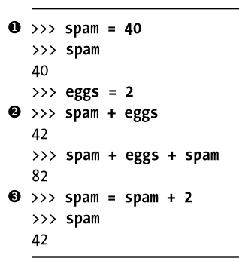
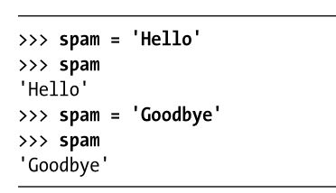
Python Basics
Variables don’t need initialized before use, they are created when assigned a value
Assigning a new value to a variable overwrites the old value

Slide 7
Python Basics
Variables must:
Be only one word
Use only letters, numbers and _
Cannot begin with a number
Variables are case sensitive!
Python convention now is to write functions and variable names in lowercase, with words separated by underscores
dog_name, alert_output
mixedCase should only be used in existing code to preserve the style. CamelCase isn’t used.

Slide 8
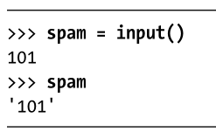
Python Basics
You cannot concatenate strings and number, so you have to convert the number to a string
Str(29)
Input always inputs a string!
You can also convert numbers stored as text to int or float

Slide 9
Understanding Modules
Python comes with a standard library that provides many modules
https://docs.python.org/2/library/
For example, to make a random number we’d need to import the random module before using it (we generally do all imports at the top of the script):
import random
print(random.randint(1,10))

Slide 10
Understanding Modules
To get the documents on all the functions at once:
help(module_name)
To list all available functions in the module:
dir(module_name)

Slide 11
Python Basics
Give this a try in a script
#This program says hello and asks for my name
print('Hello world!')
print('What is your name?') #ask for their name
myName = input()
print('It is good to meet you, ' + myName)
print('The length of your name is:')
print(len(myName))
print('What is your age?') #ask for their age
myAge = input()
print('You will be ' + str(int(myAge) + 1) + ' in a year.')

Slide 12
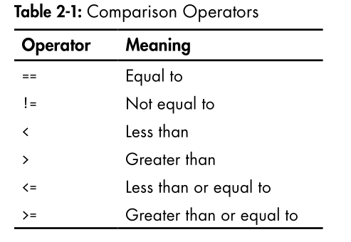
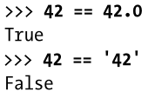
Boolean Variables
Boolean variables can be True or False (capitalization just like that)
Other comparison Operators:
Remember, = assigns a value to a variable, == checks to see if two things are equal in value

Slide 13
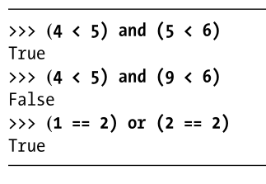
Boolean Operators
Boolean operators work like you’d expect
AND
OR
NOT
In order of precedence: NOT, AND, OR

Slide 14
IF Statements
The general form of IF statements is:
If <condition>:
<clause>
elif <condition>:
<clause>
else:
<clause>
A condition is anything that evaluates to True or False. A clause is the action to be performed.
A variable MUST be initialized prior to using it in an evaluation. Meaning it must have been given some value.
The order of statements matter as they are processed top to bottom. elifs may not execute but else will if nothing else does.

Slide 15
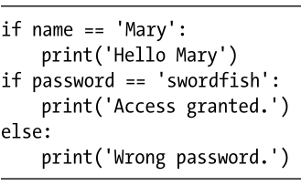
Python Blocks
Python uses blocks
Blocks begin when indentation increases
Blocks can contain other blocks
Blocks end when indentation decreases to zero or to a containing block’s indentation

Slide 16
Try this as a script
my_var = input('Enter a number greater than zero: ') #Nicer way of doing input
if int(my_var) < 5:
print ('Less than five')
elif int(my_var) < 10:
print ('Less than ten but greater than five')
elif int(my_var) <= 20:
print ('Between 10 and 20')
else:
print ('Larger than 20')

Slide 17
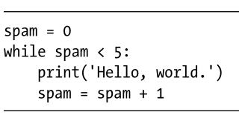
WHILE Loops
The general form of While statements is:
while <condition>:
<clause>
Spam here is being used as a counter

Slide 18
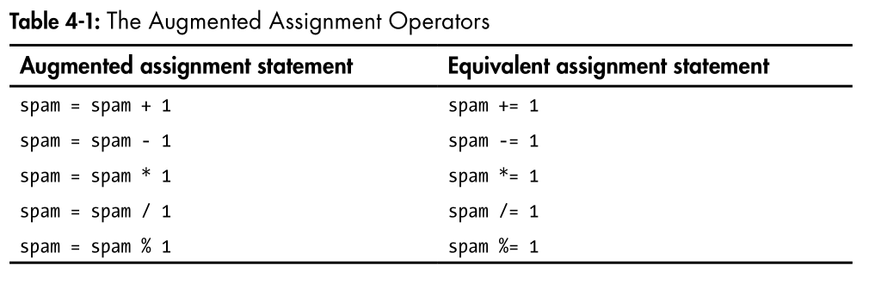
A Cleaner Way of Using Counters

Slide 19
While True
This code will run forever (or until you ctrl-C stop it)
Note that True has to be capitalized. You could do the same thing with while 1==1, or any statement that will always evaluate to True
while True:
name = input('Please type your name: ')
print(name)

Slide 20
Break
Break stops the loop
while 1==1:
name = input('Please type your name: ')
print(name)
break

Slide 21
Continue
Continue forces program flow to the condition check at the top of the block
while True:
name=input('Who are you? ')
if name != 'Joe':
continue
else:
print('Hello Joe. What is the password?')
password=input()
if password == 'swordfish':
print('Access Granted')
break
else:
print('Access Denied')

Slide 22
FOR Loops
BREAK and CONTINUE work in FOR loops, where continue goes to the next value and break stops the loop. Break and continue only work in While loops and For loops.
for i in range(5):
print (i, i*2)
if i*2 > 4:
break

Slide 23
FOR Loops
Note: Range can take three values: (start, stop, step). Negative values can be used.
for i in range(5,-5, -1):
print (i)

Slide 24
Program Termination
If you import sys, you can stop a program with sys.exit()
import sys
while True:
print('Type exit to exit')
response = input()
if response == 'exit':
sys.exit()
print('You typed ' + response + '.')

